Slide 1
Application of Chatbot to Investment Advising Using DialogFlow
Jhancy Amarshingh, Jin Hui Xu, Shikha C. Patel
Under the guidance of Dr. Tony Diana
Data Science Department, UMBC
DATA 690: Special Topics in Data Science: NLP

Slide 2
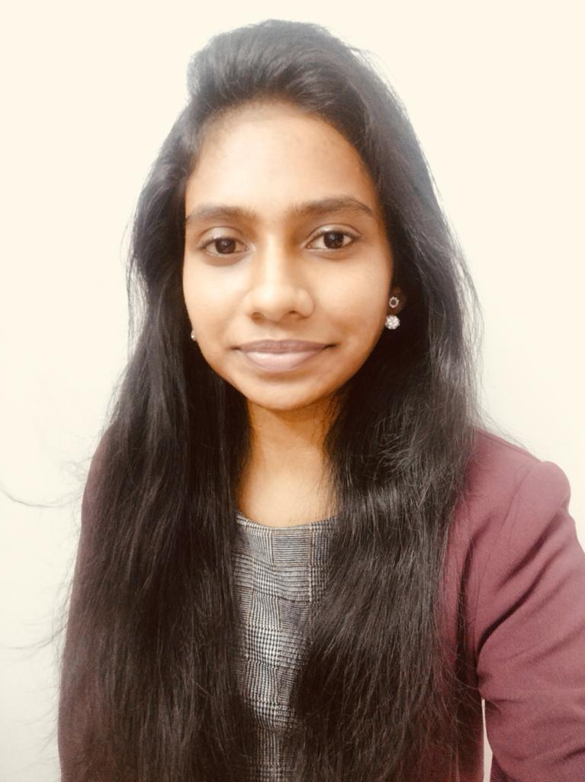


OUR TEAM
Jhancy Amarsingh
Jin Hui Xu
Shikha Patel
PO48217
AC39537
JF14891

Slide 3
TABLE OF CONTENTS
01
02
INTRODUCTION
FEATURES
03
04
METHODOLOGY
DEMONSTRATION
05
CONCLUSION

Slide 4
01
INTRODUCTION

Slide 5


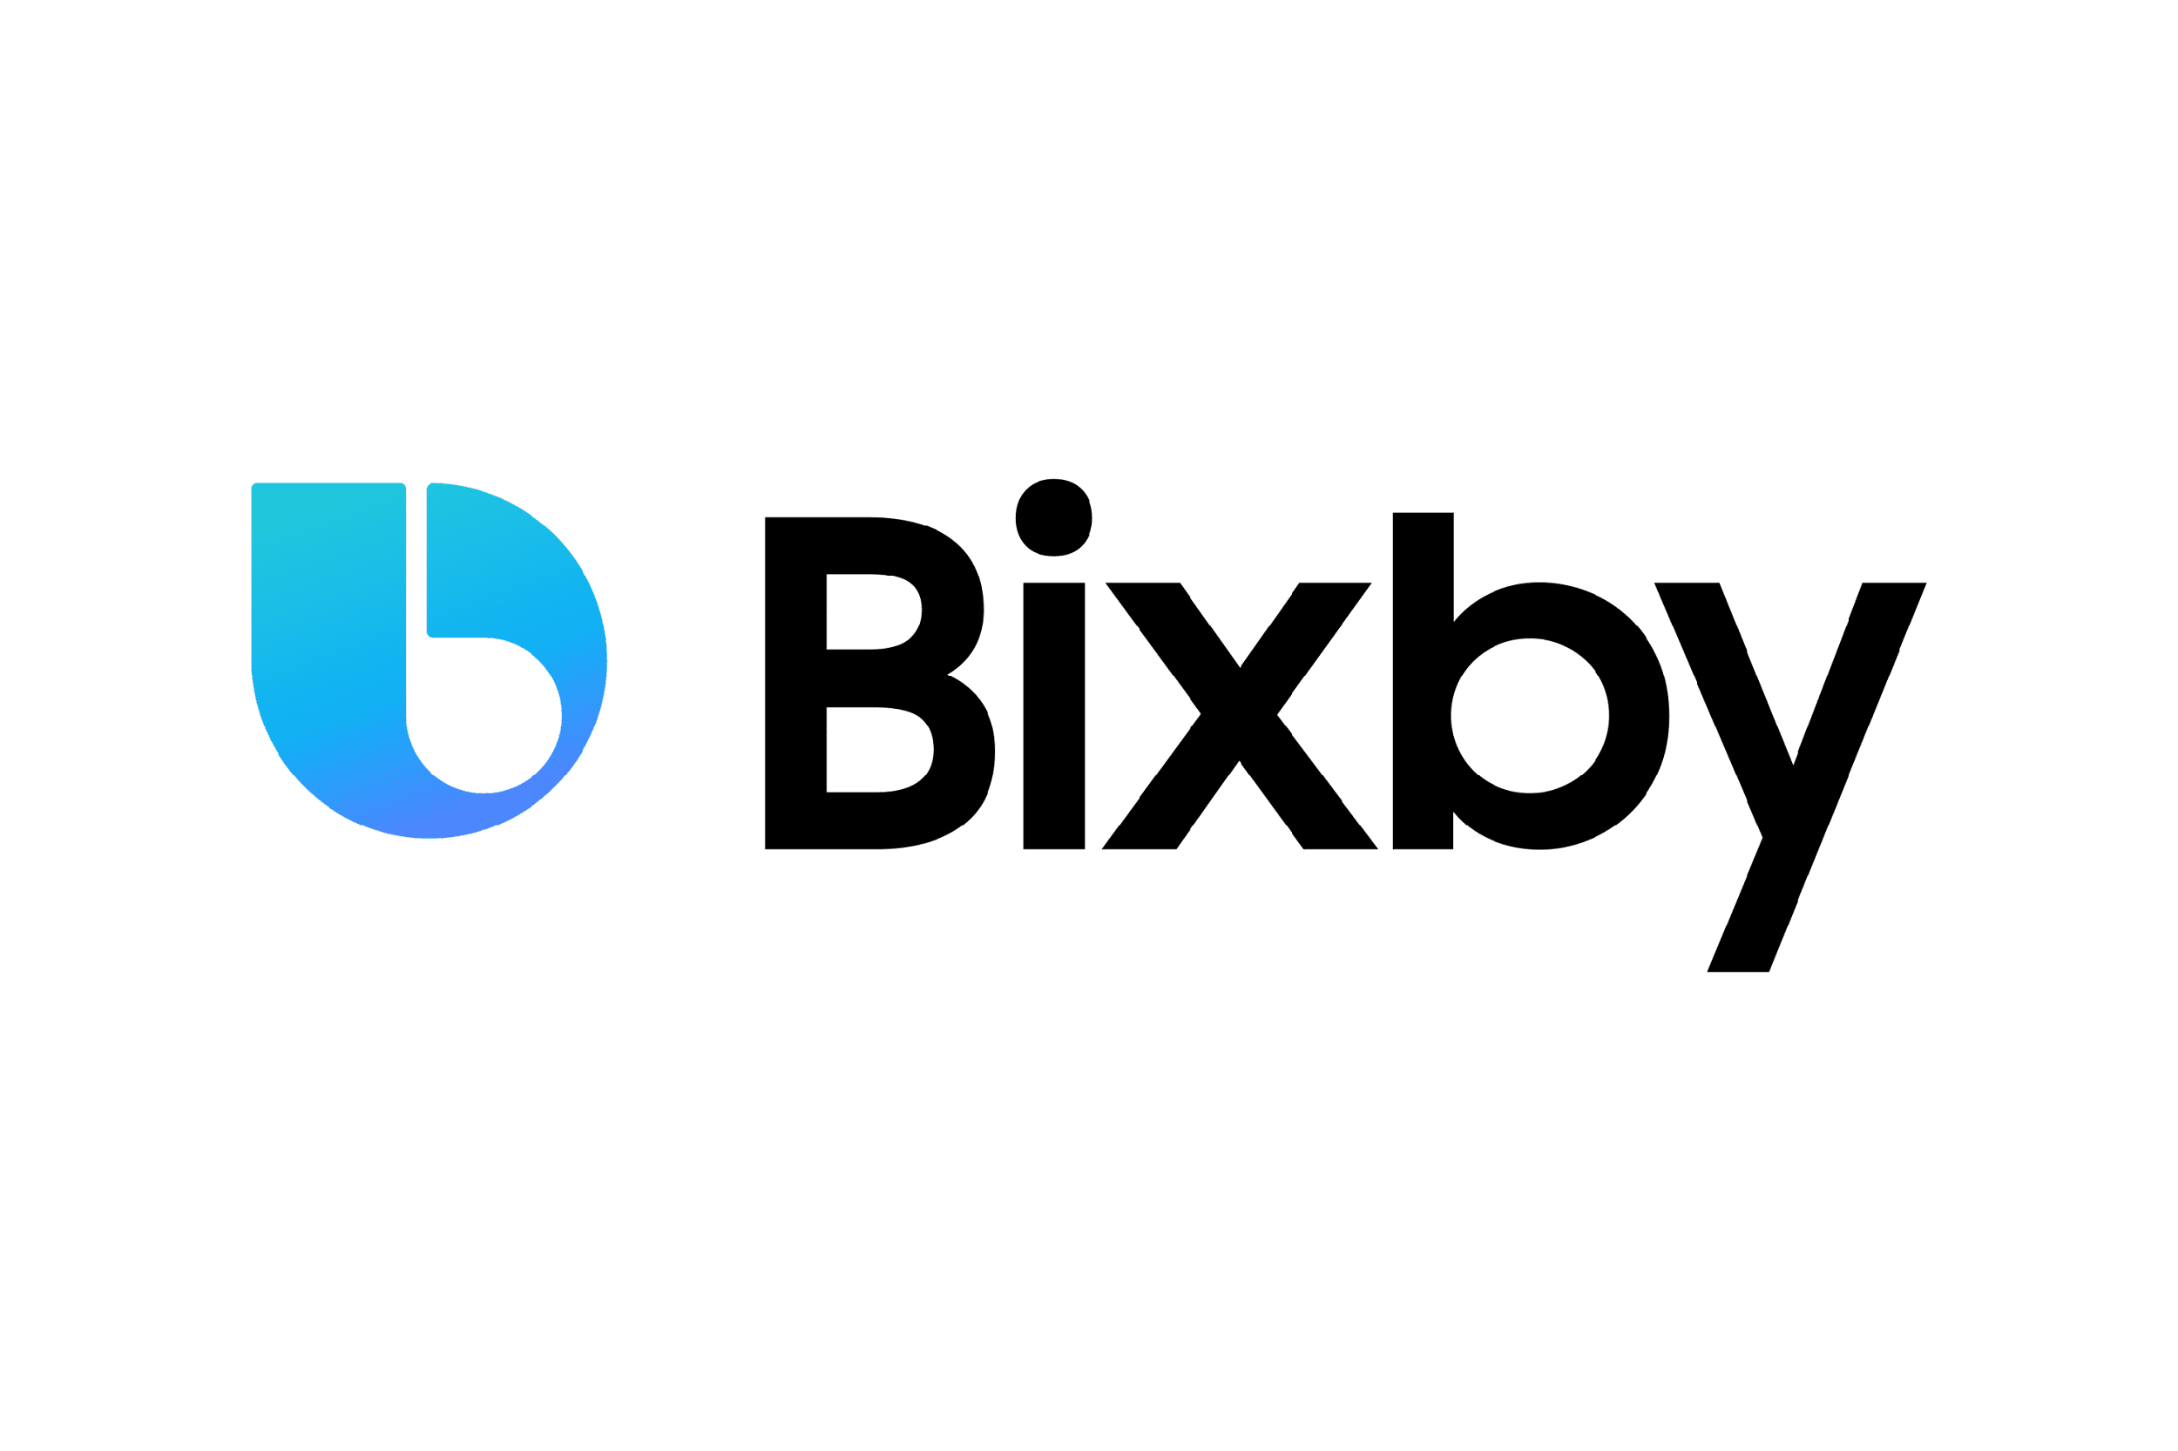
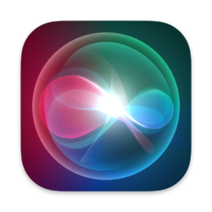
What is a Chatbot?
Appleʹs Siri
Amazonʹs Alexa
Googleʹs Okgoogle
Samsung Electronicsʹ Bixby

Slide 6
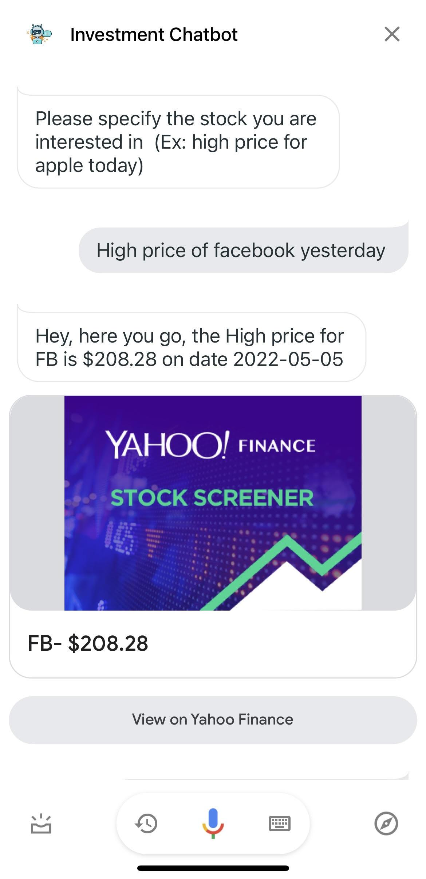
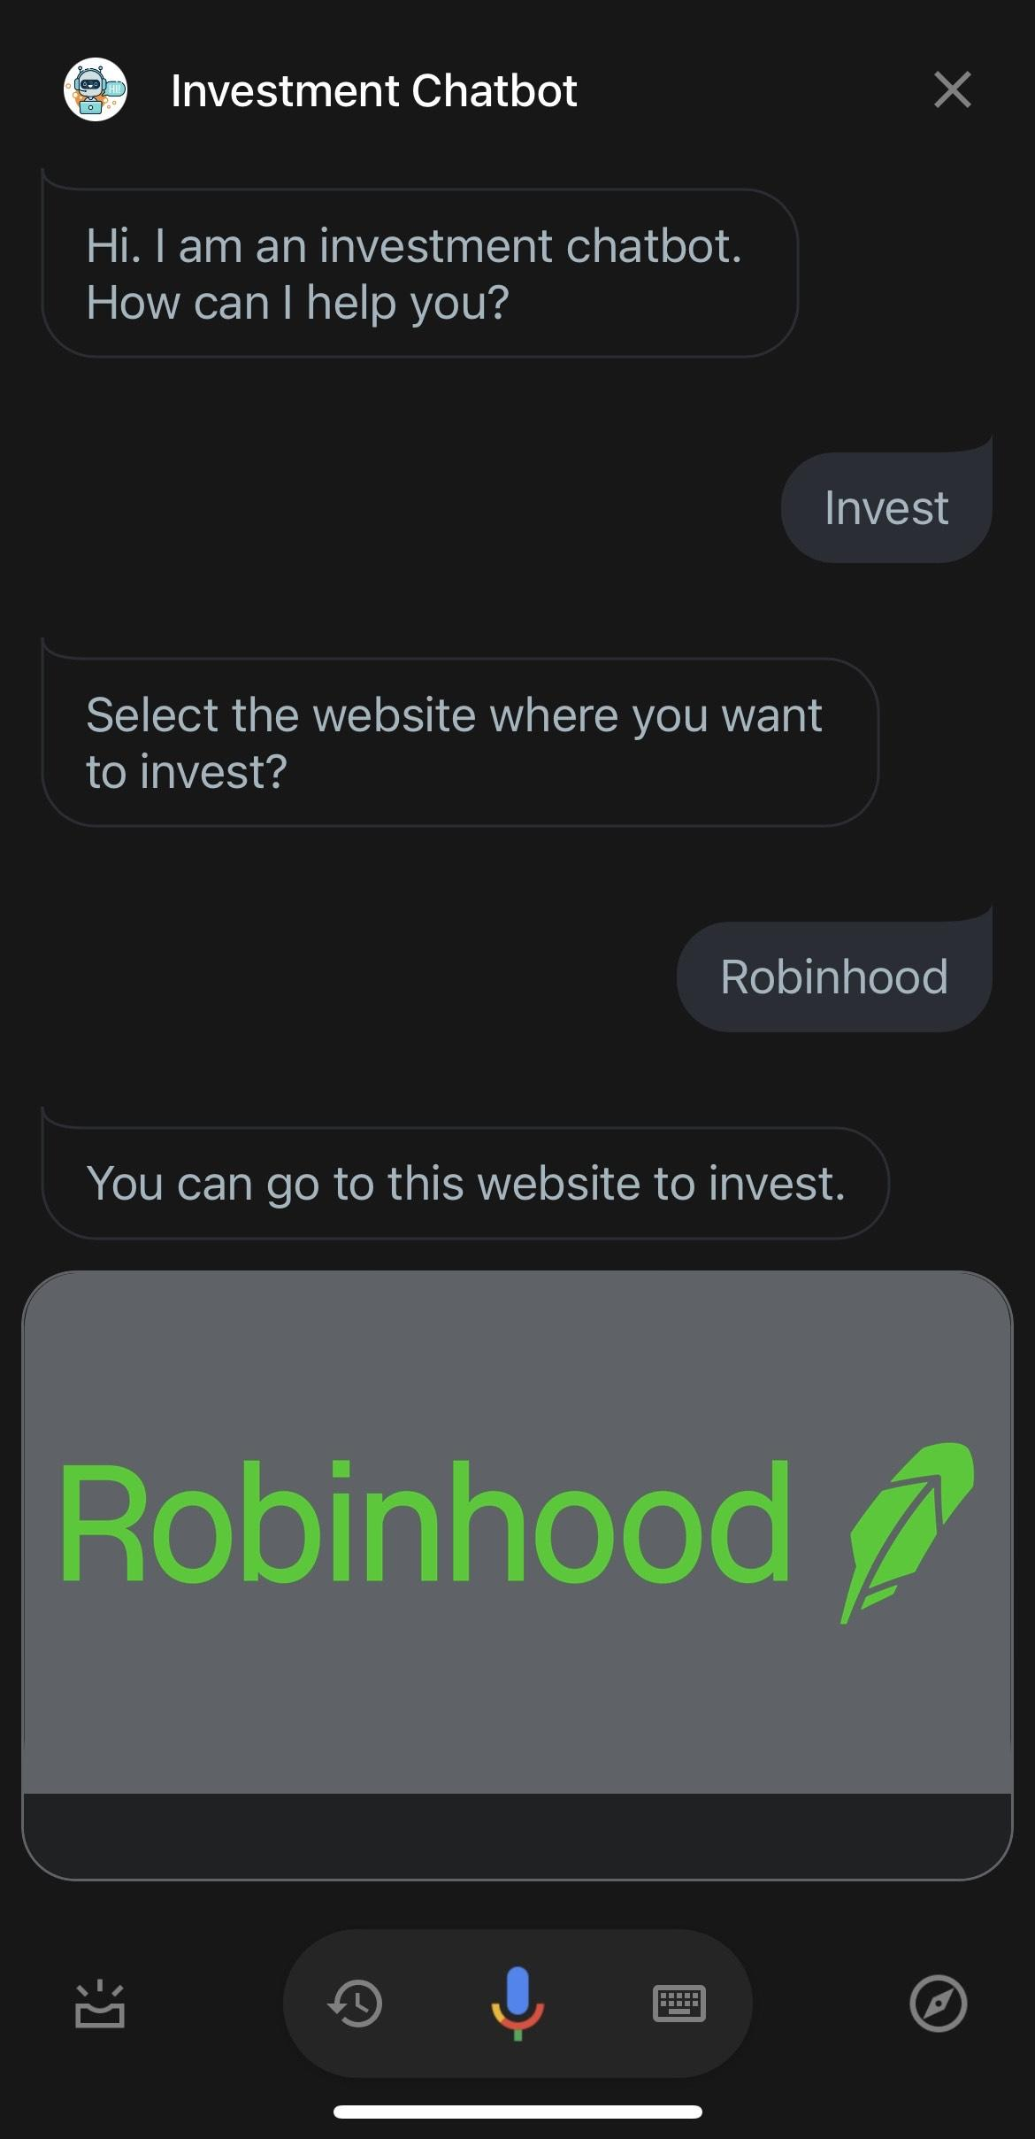
What Is An Investment Chatbot?
An interface that communicates with financial services to give information and advice to users or any investor.
Retail Banking
Investment Management
Wealth management
Investment Portfolio

Slide 7
Why our Investment Chatbot is important?
Internet Research on Investment
Guide for Investment
Forecasting Stock Prices
Recommendation based on Current Market

Slide 8
02
FEATURES

Slide 9
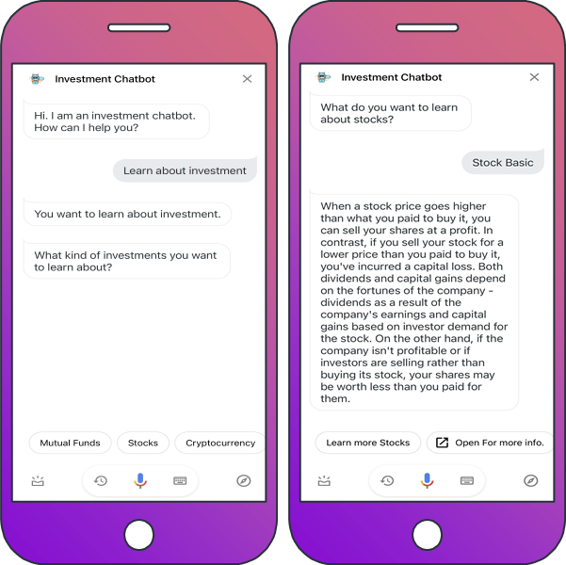
Investment Education
Provide definitions and information
Mutual Funds
Bonds
Stocks
Cryptocurrency

Slide 10
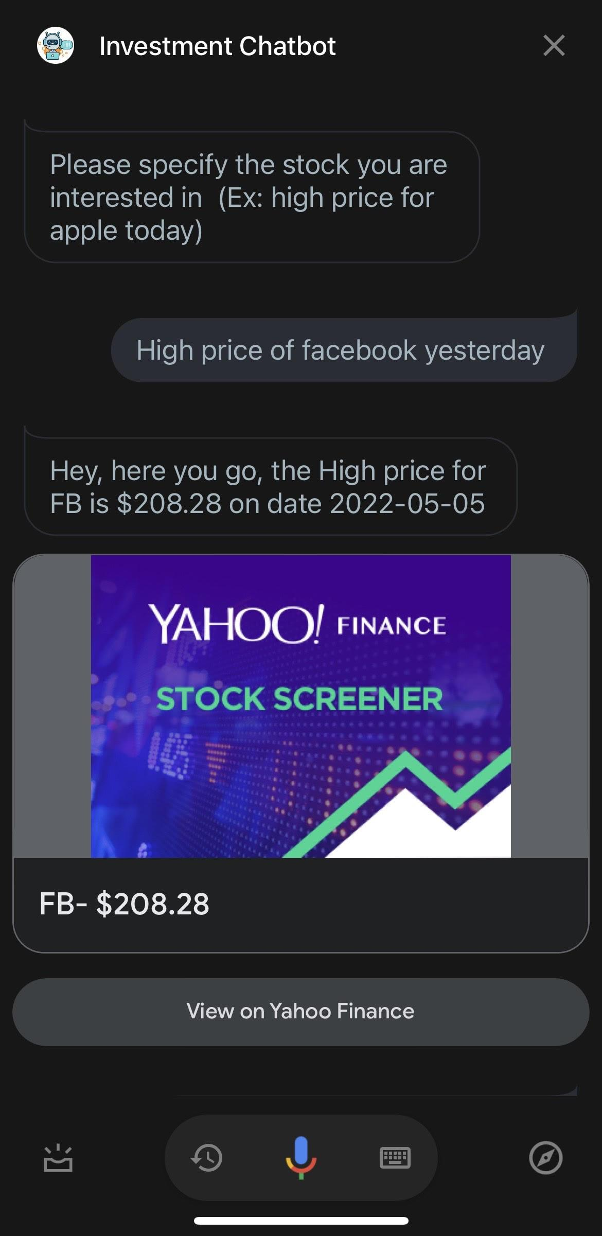
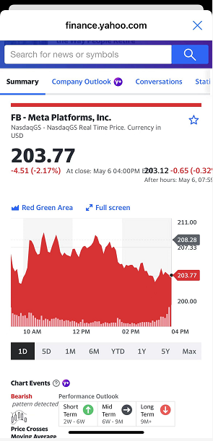
Information Retrieval
Investment tools
Real-time stock chart and price query

Slide 11
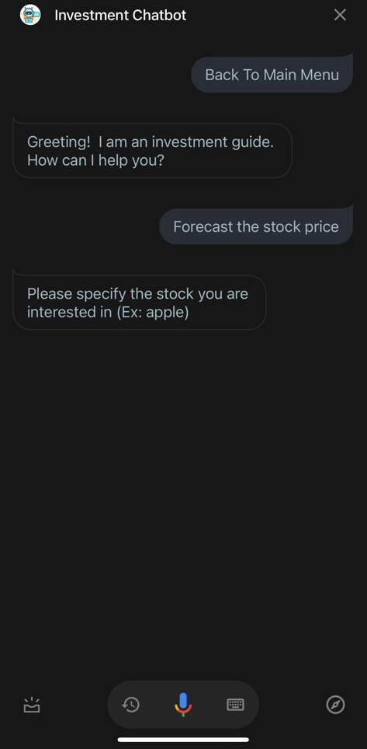
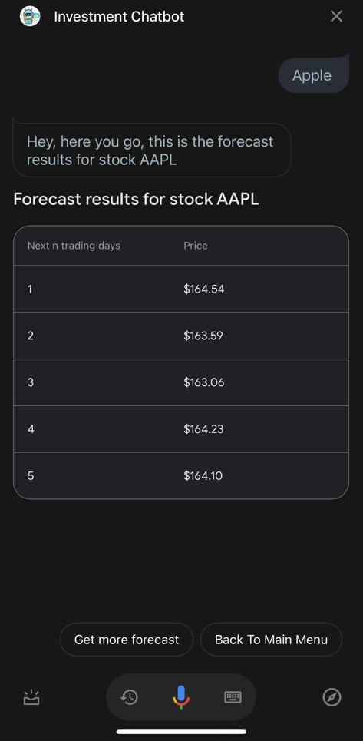
Stock Price Forecast
Time Series Analysis
Forecast 5 days realtime stock price

Slide 12
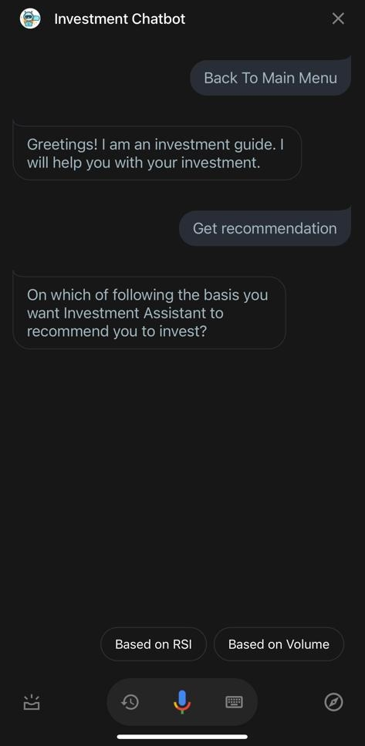
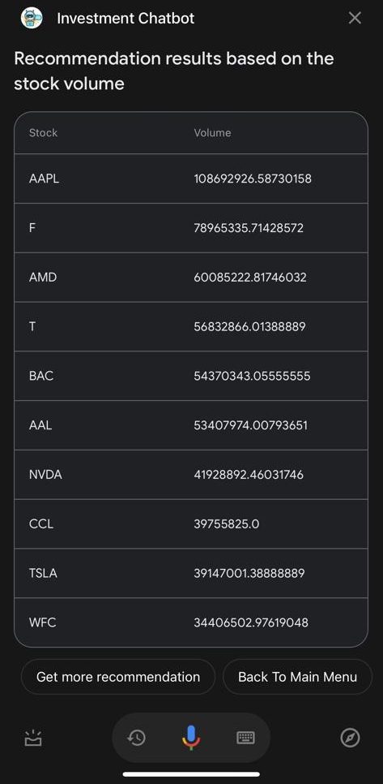
Stock Recommendation
Technical Indicators
Rational Decisions

Slide 13
03
METHODOLOGY

Slide 14
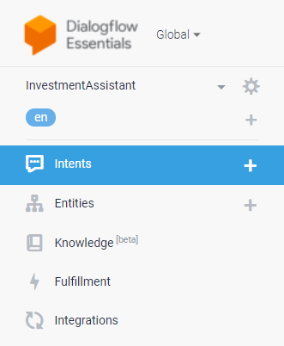

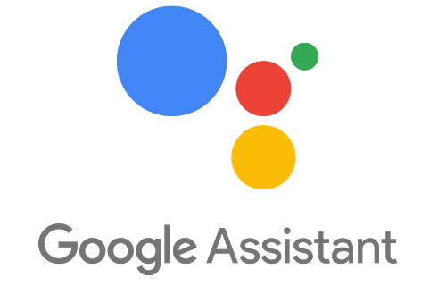
Chatbot Development
NLP techniques
POS Tagging
Tokenization
Stemming
Stop Words
Term Reinforcement
Text and Voice based

Slide 15
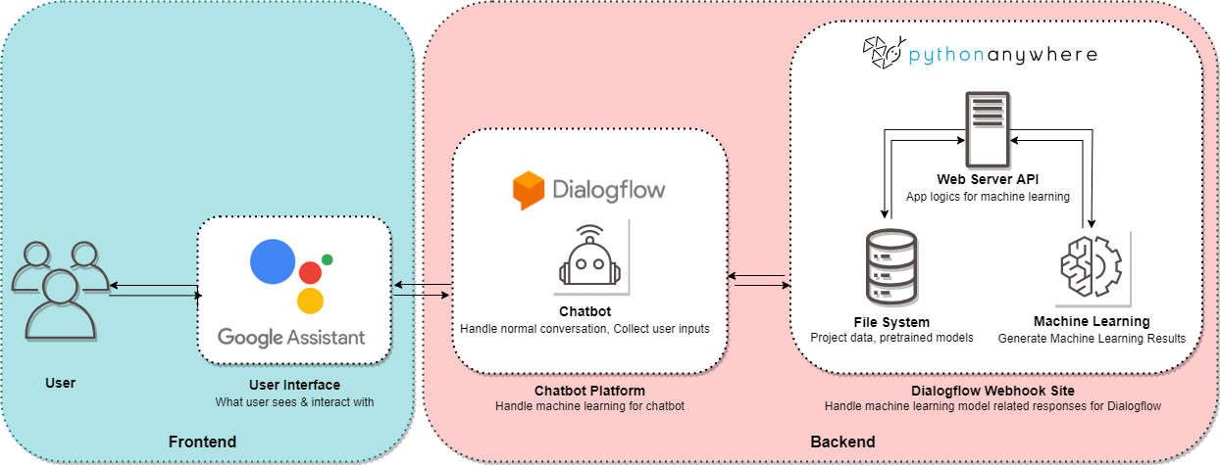
Chatbot Fulfillment and Webhook

Slide 16
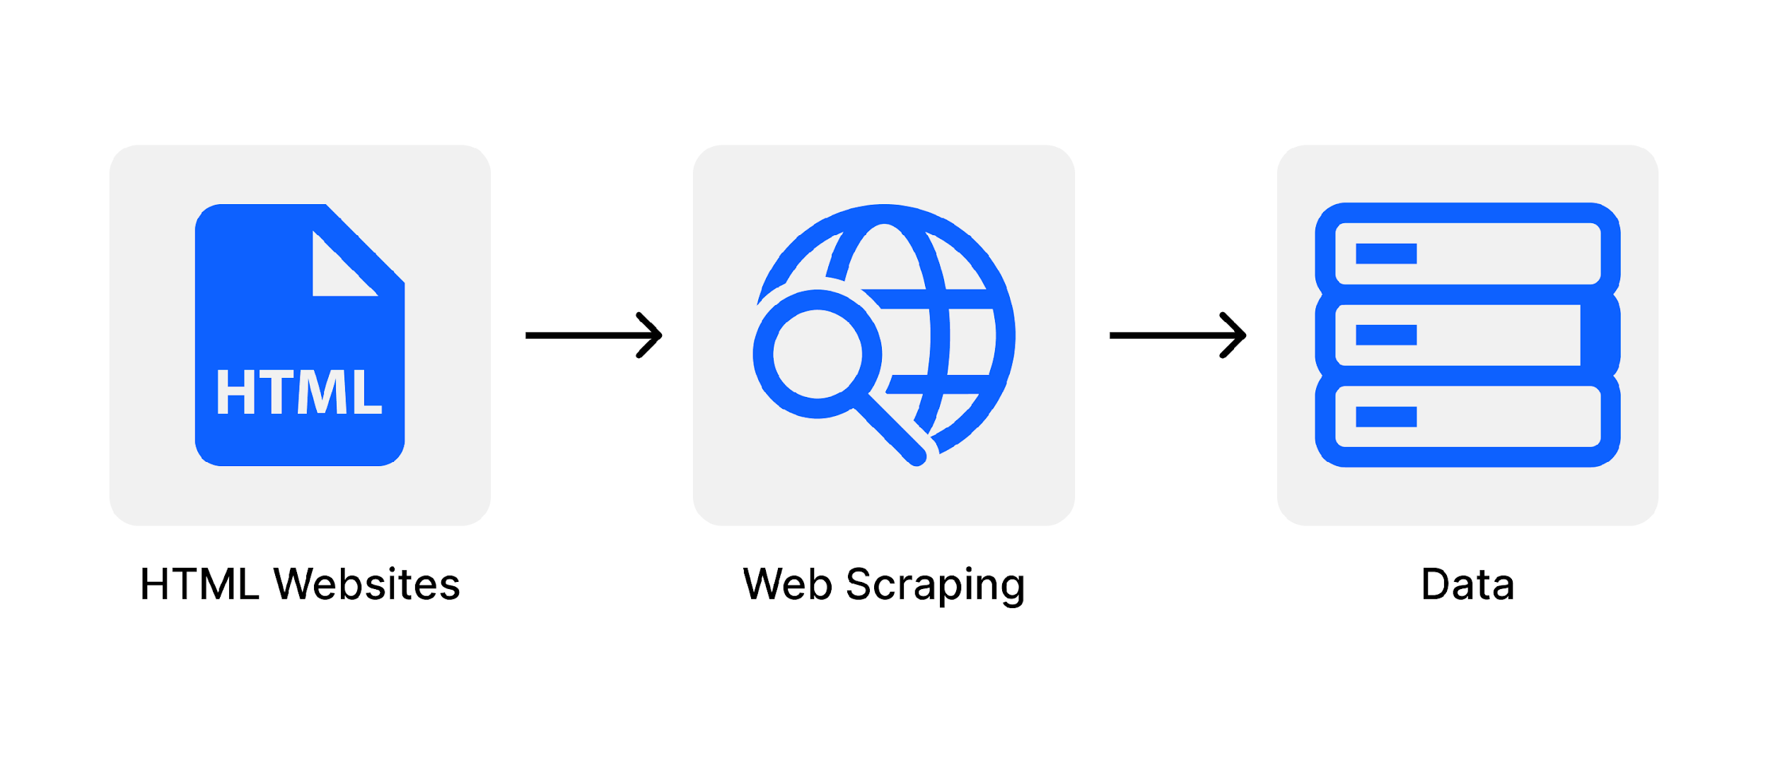
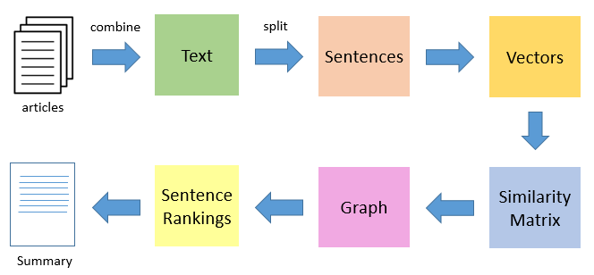
Text Summarization
Web Scraping – BeautifulSoup
Text cleaning
Text summarization - Gensim summarization

Slide 17
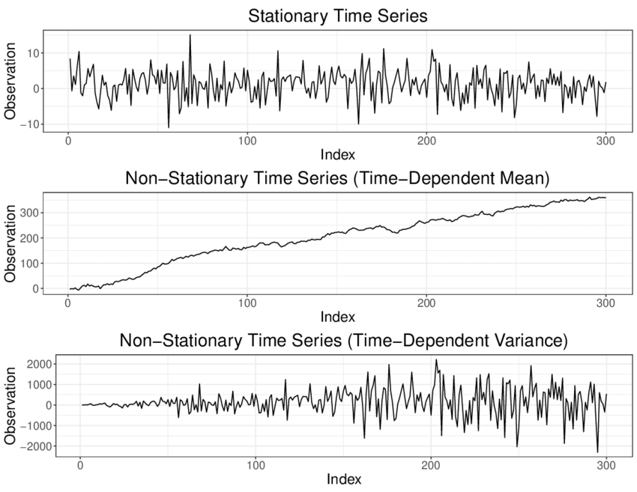

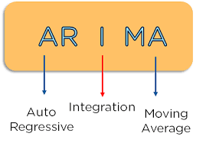
Time Series Forecasting

Slide 18
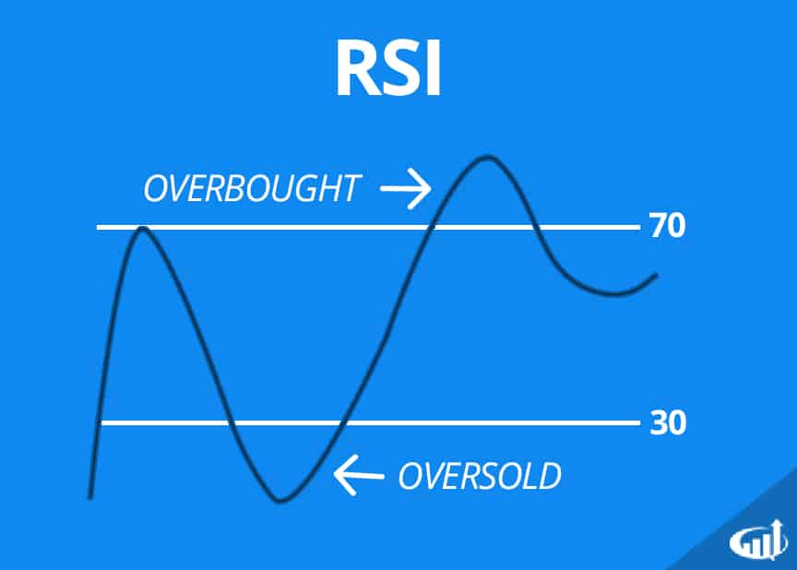
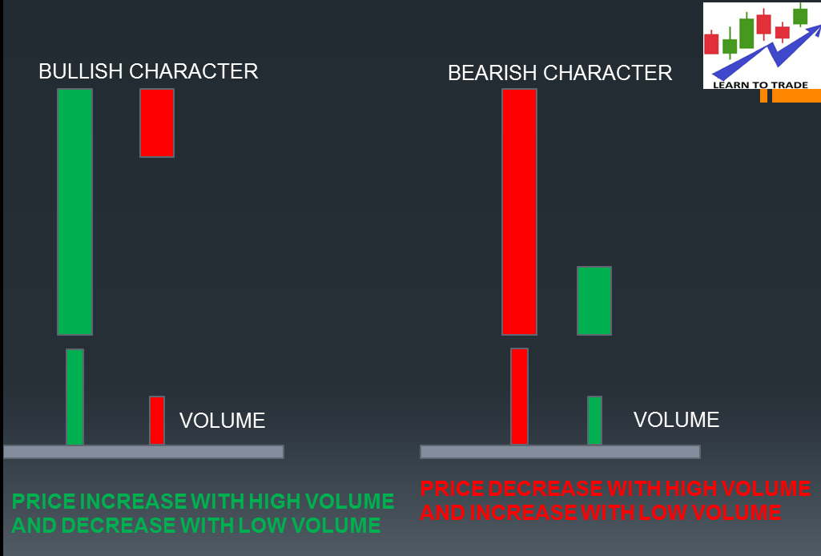
Recommendation system
Relative Strength Index

Slide 19
04
DEMONSTRATION

Slide 20
CONCLUSION
05
Limitation & Future Scope

Slide 21
LIMITATIONS
Graphs or Charts
Attractive UI
Language Compatibility
Does not allow to present graphs or charts
Google Assistant does not allow customized/ attractive UI
Compatible with no other language than English.

Slide 22
FUTURE SCOPE
Prediction & Recommendation
Language Compatibitly
EPS, Price-to-Earnings Ratio, Return on Equity (ROE) Money Flow Index (MFI), Simple Moving Average (SMA), and Bollinger Bands
Other languages like Spanish, Chinese, Hindi, etc
Trading API
Mutual Funds, Bonds & Crypto-by-crypto
Places the trading orders after the conversation.
Price predictions and recommendations also based on Neural Networks

Slide 23
REFERENCES
Dasagrandhi, C. S., 2022). 22 reasons why investing in Chatbots is no longer an option. Blog. Retrieved May 1, 2022, from https://blog.vsoftconsulting.com/blog/22-reasons-why-investing-in-chatbots-is-no-longer-an-option
Karnam, M. (2019, September 24). How to build an investment management chatbot. IBM. https://www.ibm.com/cloud/blog/announcements/build-investment-management-chatbot
Hwang, Sewoong & Kim, Jonghyuk. (2021). Toward a Chatbot for Financial Sustainability. Sustainability. 13. 3173. 10.3390/su13063173.
D3VTech. (2021, August 2). The AI Behind Google Dialogflow - How it Differs from Other Conversational AI | Cloud Insights | D3V Technology Solutions. https://www.d3vtech.com/insights/the-ai-behind-google-dialogflow-how-it-differs-from-other-conversational-ai
Mitchell, C. (2022, February 10). How to Use Volume to Improve Your Trading. Investopedia. https://www.investopedia.com/articles/technical/02/010702.asp
Hwang, S.; Kim, J. Toward a Chatbot for Financial Sustainability. Sustainability 2021, 13, 3173. https://doi.org/10.3390/su13063173
Botbot.AI. (2018, February 2). Banking & Investment - Chatbot for Enterprise Productivity. Botbot.AI. https://botbot.ai/solutions/banking-investment-chatbot/
Dhaduk, H. (2021, July 18). Stock market forecasting using Time Series analysis With ARIMA model. Analytics Vidhya. https://www.analyticsvidhya.com/blog/2021/07/stock-market-forecasting-using-time-series-analysis-with-arima-model/
Fernando, J. (2022, February 19). Relative Strength Index (RSI). Investopedia.
Finra. (n.d.). Learn to Invest | FINRA.org. https://www.finra.org/investors/learn-to-invest

Slide 24
THANKS!

